Slide 1
Software Architecture & Construction
Design Patterns -1

Slide 2
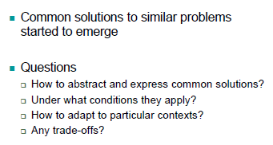
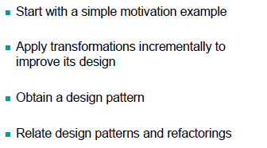
Insights
What excited it all
Roadmap

Slide 3
Climate Change Example
Brief:
  Write a program that monitors the temperature measured in a thermometer and displays it in two different screens
    Celsius
    Fahrenheit
Condition
  Every time the temperature changes the displays must be updated

Slide 4
Attempt -1
import java.util.*;
public class Temperature {
public static void main(String[] args) {
double currentTemp = 0;
String displayC="", displayF="";
do {
// C = k - 273.15
displayC = String.valueOf(currentTemp - 273.15);
// F = (K × 1.8) - 459.67
displayF = String.valueOf(currentTemp*1.8 - 459.67);
System.out.println(displayC + "C");
System.out.println(displayF + "F");
System.out.print("New temperature: ");
Scanner scan = new Scanner(System.in);
currentTemp = scan.nextDouble();
}
while(currentTemp >= 0);
}
}

Slide 5
Attempt -2
public class Thermometer {
double currentTemp = 0;
String displayC="", displayF="";
public void readValue() {
do {
displayC = String.valueOf(currentTemp - 273.15); // C = k - 273.15
displayF = String.valueOf(currentTemp*1.8 - 459.67); // F = (K × 1.8) - 459.67
System.out.println(displayC + "C");
System.out.println(displayF + "F");
System.out.print("New temperature: ");
Scanner scan = new Scanner(System.in);
currentTemp = scan.nextDouble();
}
while(currentTemp >= 0);
}
}
public class Temperature {
public static void main(String[] args) {
Thermometer t1 = new Thermometer();
t1.readValue();
}
}

Slide 6
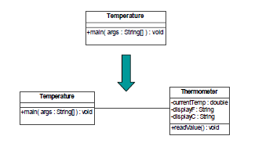
Attempt 2- UML Model

Slide 7
Attempt 2 - Reflections
What did we just do?
  A refactoring – Extract a class
Are we there yet?
  Any suggestions?

Slide 8
Attempt -3 (1)
public class Thermometer {
double currentTemp = 0;
DisplayFahrenheit displayF = new DisplayFahrenheit();
DisplayCentigrade displayC = new DisplayCentigrade();
public void readValue() {
do {
System.out.println(displayC.displayValue(currentTemp));
System.out.println(displayF.displayValue(currentTemp));
System.out.print("New temperature: ");
Scanner scan = new Scanner(System.in);
currentTemp = scan.nextDouble();
}
while(currentTemp >= 0);
}
}
public class Temperature {
public static void main(String[] args) {
Thermometer t1 = new Thermometer();
t1.readValue();
}
}

Slide 9
Attempt -3(2)
public class DisplayFahrenheit {
private double computeValue (double temp) {
return temp*1.8 - 459.67;
}
public String displayValue(double temp) {
return String.valueOf(computeValue(temp)) + "F";
}
}
public class DisplayCentigrade {
private double computeValue (double temp) {
return temp - 273.15;
}
public String displayValue(double temp) {
return String.valueOf(computeValue(temp)) + "C";
}
}

Slide 10
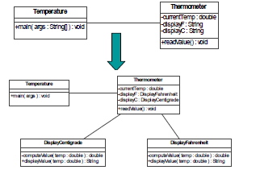
Attempt 3 – UML model

Slide 11
Attempt 3 - Reflections
What have we just done?
  Performed 2 refactorings:
    Extracted a class i.e., DisplayFahrenheit, DisplayCentigrade
    Extract method i.e., computeValue
But, are we there yet?
  Question:
    What if we would like to have three displays instead of two?

Slide 12
Attempt 4 – naïve approach
public class Thermometer {
double currentTemp = 0;
DisplayFahrenheit displayF = new DisplayFahrenheit();
DisplayCentigrade displayC = new DisplayCentigrade();
DisplayCentigrade displayC2 = new DisplayCentigrade();
public void readValue() {
do {
System.out.println(displayC.displayValue(currentTemp));
System.out.println(displayF.displayValue(currentTemp));
System.out.println(displayC2.displayValue(currentTemp));
System.out.print("New temperature: ");
Scanner scan = new Scanner(System.in);
currentTemp = scan.nextDouble();
}
while(currentTemp >= 0);
}
}

Slide 13
Attempt -4(1)
public abstract class Display {
public abstract String displayValue(double temp);
}
public class DisplayCentigrade extends Display {
private double computeValue (double temp) {
return temp - 273.15;
}
public String displayValue(double temp) {
return String.valueOf(computeValue(temp)) + "C\n";
}
}
public class DisplayFahrenheit extends Display {
private double computeValue (double temp) {
return temp*1.8 - 459.67;
}
public String displayValue(double temp) {
return String.valueOf(computeValue(temp)) + "F\n";
}
}

Slide 14

Attempt -4(2)
public class Thermometer {
double currentTemp = 0;
List<Display> listDisplays = new LinkedList<Display>();
public void attach(Display d) {
listDisplays.add(d);
}
public void detach(Display d) {
listDisplays.remove(d);
}
public void readValue() {
do {
for (Display display : listDisplays)
System.out.print(display.displayValue(currentTemp));
System.out.print("New temperature: ");
Scanner scan = new Scanner(System.in);
currentTemp = scan.nextDouble();
}
while(currentTemp >= 0);
}
}

Slide 15
Attempt -4(2)
public class Temperature {
public static void main(String[] args) {
Thermometer t1 = new Thermometer();
// Creates three displays
Display displayF = new DisplayFahrenheit();
Display displayC = new DisplayCentigrade();
Display displayC2 = new DisplayCentigrade();
// Adds displays to thermometer
t1.attach(displayF); t1.attach(displayC); t1.attach(displayC2);
// Starts reading value
t1.readValue();
// Detaches a display
t1.detach(displayC2);
}
}

Slide 16
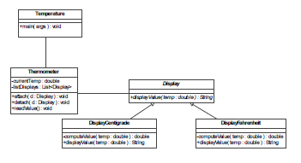
Attempt 4 – UML model

Slide 17
Attempt 4 - Reflections
What have we just done?
  We performed one more refactoring
    Extract a superclass i.e., Display
  We improved the flexibility of design
Are we there yet?
Question:
  What if the state is more complex?
    For example, the thermometer records temperature and wind speed

Slide 18

Attempt 5 – naïve approach
public class Thermometer {
double currentTemp = 0;
double windSpeed =0;
…
public void readValue() {
do {
for (Display display : listDisplays)
System.out.print(display.displayValue(currentTemp, windSpeed));
…
}
while(currentTemp >= 0);
}
}

Slide 19

Attempt -5(1)
public class Temperature {
public static void main(String[] args) {
Thermometer t1 = new Thermometer();
// Creates three displays
Display displayF = new DisplayFahrenheit(t1);
Display displayC = new DisplayCentigrade(t1);
Display displayC2 = new DisplayCentigrade(t1);
// Adds displays to thermometer
t1.attach(displayF); t1.attach(displayC); t1.attach(displayC2);
// Starts reading value
t1.readValue();
// Detaches a display
t1.detach(displayC2);
}
}

Slide 20
Attempt -5(2)
public abstract class Display {
protected Thermometer thermometer;
public abstract String displayValue();
public Display(Thermometer therm) {
thermometer = therm;
}
}
public class DisplayCentigrade extends Display {
public DisplayCentigrade (Thermometer therm) {
super(therm);
}
private double computeValue () {
return thermometer.getTemp() - 273.15;
}
public String displayValue() {
return String.valueOf(computeValue())+ "C " + thermometer.getWindSpeed()+ " \n" ;
}
}
public class DisplayFahrenheit extends Display {
public DisplayFahrenheit (Thermometer therm) {super(therm); }
private double computeValue () { return thermometer.getTemp()*1.8 - 459.67; }
public String displayValue() {
return String.valueOf(computeValue()) + "F " + thermometer.getWindSpeed() + " \n";
}
}

Slide 21
Attempt -5(3)
public class Thermometer {
List<Display> listDisplays = new LinkedList<Display>();
private double currentTemp = 0;
public double getTemp() {
return currentTemp;
}
public void setTemp(double temp) {
currentTemp = temp;
}
double windSpeed =0;
public double getWindSpeed() {
return windSpeed;
}
public void setWindSpeed(double windSpeed) {
this.windSpeed = windSpeed;
}
…
}

Slide 22
Attempt -5(4)
public class Thermometer {
…
public void attach(Display d) {
listDisplays.add(d);
}
public void detach(Display d) {
listDisplays.remove(d);
}
public void readValue() {
do {
for (Display display : listDisplays)
System.out.print(display.displayValue());
System.out.print("New temperature: ");
Scanner scan = new Scanner(System.in);
currentTemp = scan.nextDouble();
System.out.print("New Wind Speed: ");
scan = new Scanner(System.in);
windSpeed = scan.nextDouble();
}
while(currentTemp >= 0);
}
}

Slide 23
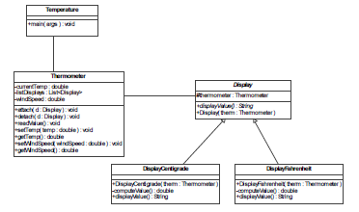
Attempt 5 – UML Model

Slide 24
Attempt 5 - Reflections
What have we just done?
  We applied two refactorings
    Encapsulate field
Our design now supports:
  adding and removing displays
  displays of different types
  complex state
Is this a general solution?
  Applicable to other similar problems

Slide 25
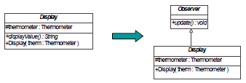
Display & observer
public abstract class Display extends Observer {
protected Thermometer thermometer;
public Display(Thermometer therm) {
thermometer = therm;
}
}
public abstract class Observer {
public abstract void update();
}

Slide 26
Subject
public class Subject {
List<Observer> listObservers = new LinkedList<Observer>();
public void attach(Observer o) {
listObservers.add(o);
}
public void detach(Observer o) {
listObservers.remove(o);
}
public void notifyObservers() {
for (Observer obv : listObservers) obv.update();
}
}

Slide 27
Thermometer (concrete subject)
public class Thermometer extends Subject {
private double currentTemp = 0;
public double getTemp() { return currentTemp; }
public void setTemp(double temp) { currentTemp = temp;}
double windSpeed =0;
public double getWindSpeed() { return windSpeed; }
public void setWindSpeed(double windSpeed) { this.windSpeed = windSpeed;}
public void readValue() {
do {
notifyObservers();
System.out.print("New temperature: ");
Scanner scan = new Scanner(System.in);
currentTemp = scan.nextDouble();
System.out.print("New Wind Speed: ");
scan = new Scanner(System.in);
windSpeed = scan.nextDouble();
}
while(currentTemp >= 0);
}
}

Slide 28
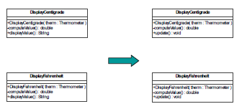
Centigrade & Fahrenheit

Slide 29
Centigrade & Fahrenheit
public class DisplayCentigrade extends Display {
public DisplayCentigrade (Thermometer therm) {
super(therm);
}
private double computeValue () {
return thermometer.getTemp() - 273.15;
}
public void update() {
String msg = String.valueOf(computeValue()) + "C " + thermometer.getWindSpeed();
System.out.println (msg);
}
}
public class DisplayFahrenheit extends Display {
public DisplayFahrenheit (Thermometer therm) {
super(therm);
}
private double computeValue () {
return thermometer.getTemp()*1.8 - 459.67;
}
public void update() {
String msg = String.valueOf(computeValue()) + "F " + thermometer.getWindSpeed() + " \n";
System.out.print(msg);
}
}

Slide 30
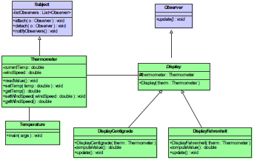
Temperature Example

Slide 31
What have just done?
Our design now supports
  adding and removing displays
  displays of different types
  complex state
Is this a general solution?
  Applicable to other similar problems

Slide 32
Design Example 2 – Stock Exchange
A financial institution in the UK buys and sells stocks throughout the world
It has branches in Europe and US
It needs to keep printed records of the stock value changes in euros and dollars
Design/Write a program that prints these records
Can you apply experience from thermometer example?

Slide 33
Task
Produce a final Stock Example similar to the final Temperature example
  Show your Observer and Subject classes.

Slide 34
Stock Example
A financial institution in the Ethiopia buys and sells stocks throughout the world
  It has branches in Europe and US
  It needs to keep printed records of the stock value changes in euros and dollars
  Design a program that prints these records
Can you apply experience from thermometer example?

Slide 35
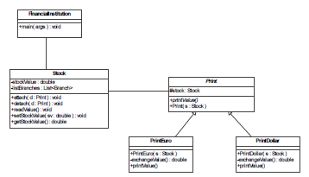
Stock – UML view
(example solution)

Slide 36
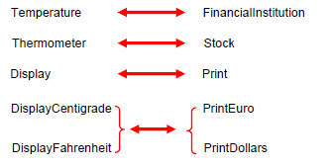
Differences/similarities

Slide 37
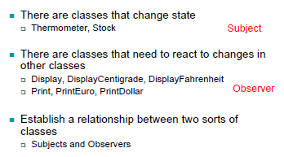
Big Picture

Slide 38
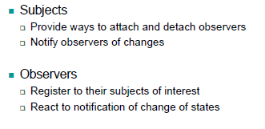
And their behaviour?

Slide 39
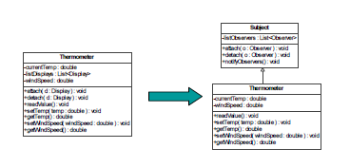
Making solution more general

Slide 40
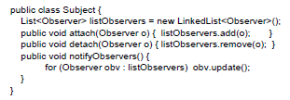
Java description - Subject

Slide 41
Thermometer (Concrete subject)
public class Thermometer extends Subject {
private double currentTemp = 0;
public double getTemp() { return currentTemp; }
public void setTemp(double temp) { currentTemp = temp;}
double windSpeed =0;
public double getWindSpeed() { return windSpeed; }
public void setWindSpeed(double windSpeed) { this.windSpeed = windSpeed;}
public void readValue() {
do {
notifyObservers();
System.out.print("New temperature: ");
Scanner scan = new Scanner(System.in);
currentTemp = scan.nextDouble();
System.out.print("New Wind Speed: ");
scan = new Scanner(System.in);
windSpeed = scan.nextDouble();
} while(currentTemp >= 0);
}
}

Slide 42
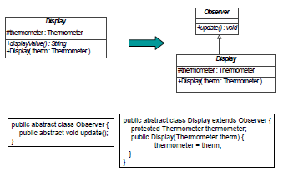
Display & Observer

Slide 43
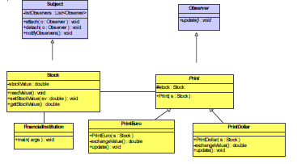
Generalised Stock Example

Slide 44
Why does it work?
We abstracted and modularized observer and subject behaviour from their concrete instances
We created a model or pattern to capture this relationship
Design Pattern
  Description of communicating objects and classes that are customized to solve a general design problem in a particular context

Slide 45
Key lessons learned
Improve design by applying refactorings
Designs patterns can be regarded as targets for refactoring

Slide 46
Next time
We will look more closely at some example patterns:
  Observer
  Adapter
  Singleton

